Slide 1
Overview of all Circuit Components
Reviuwu

Slide 2
Content.zip

Slide 3
Concepts
Voltage: how much “potential” the circuit has to flow Current: how fast the electricity is moving in the circuit Resistance: how much the wire slows down the flow of electrons
Power: how much energy you can dissipate in a certain amount of time (energy divided by time)
Magnetic flux: how many “magnetic field lines” hit a certain amount of area
Capacitance: how good a capacitor is at storing charge Inductance: how good an inductor is at charging up
Impedance: sum of reactance (resistance non-intrinsic to the material) and resistance (intrinsic to the material)

Slide 4
Units
Voltage (V): Volts (V) Current (I): Amps (A) Resistance (R): Ohms (Ω)
Energy (U): Joules (J) Time (t): Seconds (s) Power (P): Watts (W)
Capacitance (C): Farads (F) Charge (Q): Coulombs (C) Inductance (L): Henrys (H)
Magnetic Flux (Φ): Webers (Wb) Reactance (X): Ohms (Ω) Impedance (Z): Ohms (Ω)

Slide 5
Capacitors and Conductors

Slide 6
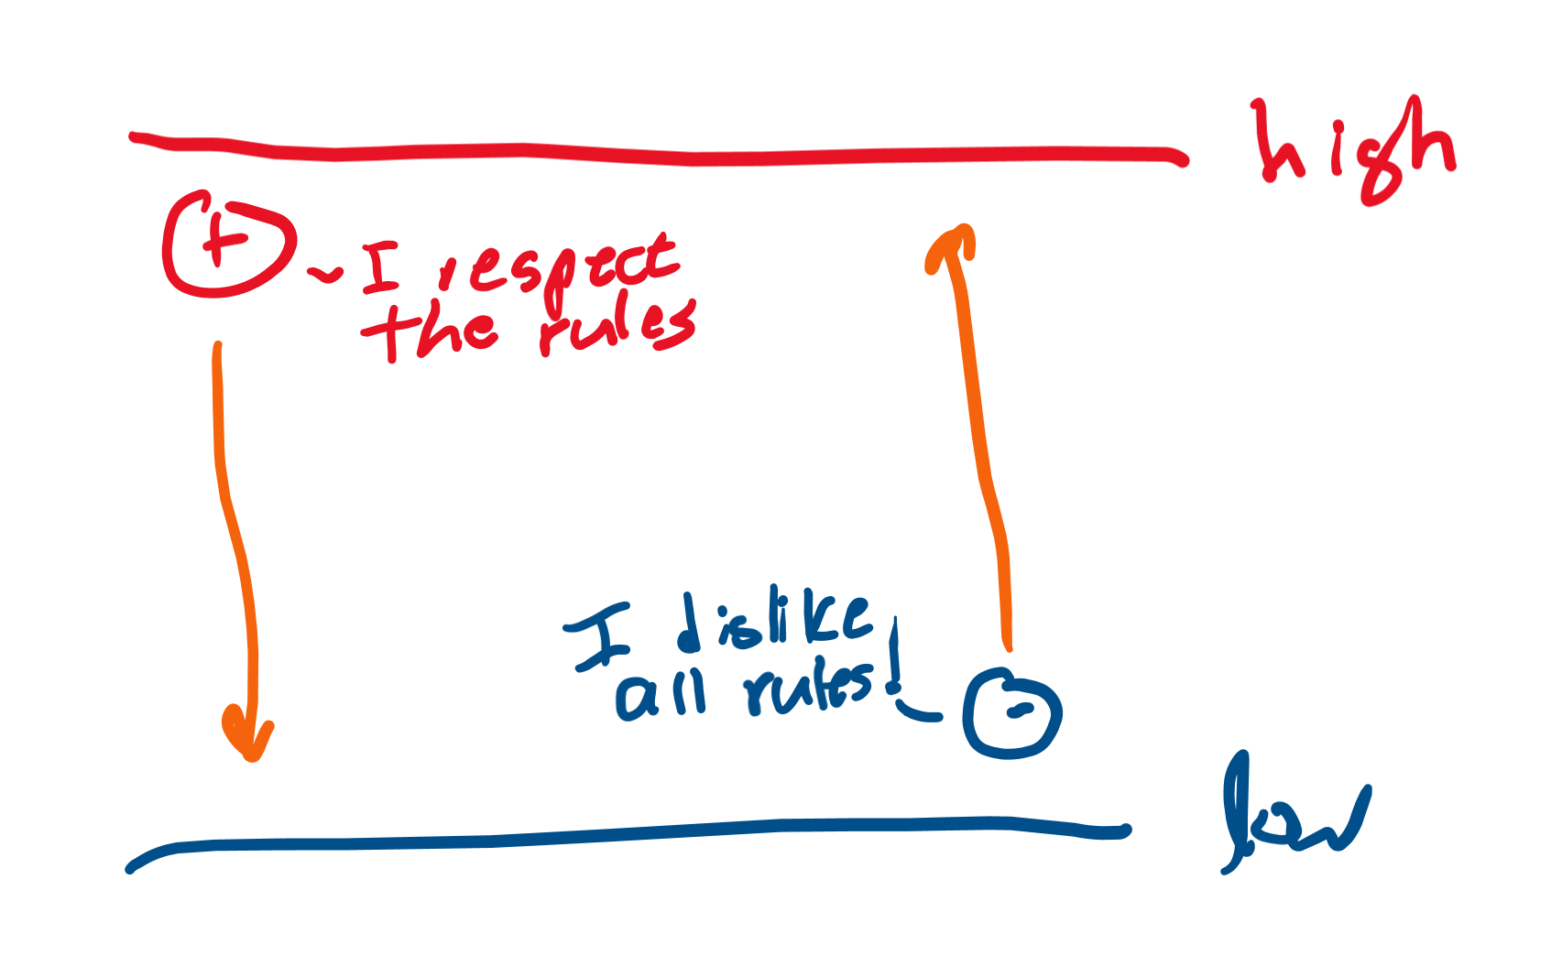
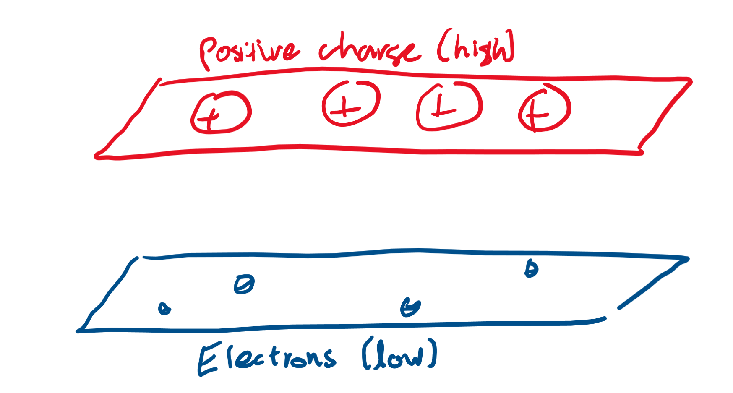
Potential difference
Like gravity pulls objects from “high” to “low,” positive charges want to move from “high potential” to “low potential.”
Negative charges “break the rules” and go from low to high potential.
Low potential areas have lots of negative charge while high potential areas have lots of positive charge.

Slide 7
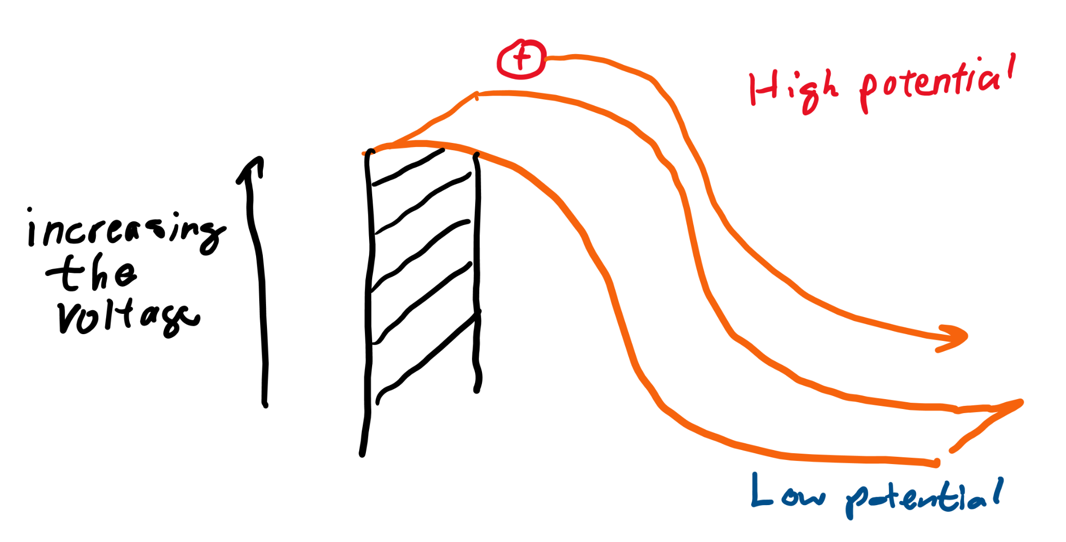
Voltage
Voltage is the difference in potentials, and is sometimes called the “electromotive force” or EMF because it is what moves electric charge.
The higher the voltage, the more charges want to move from high to low potential.

Slide 8
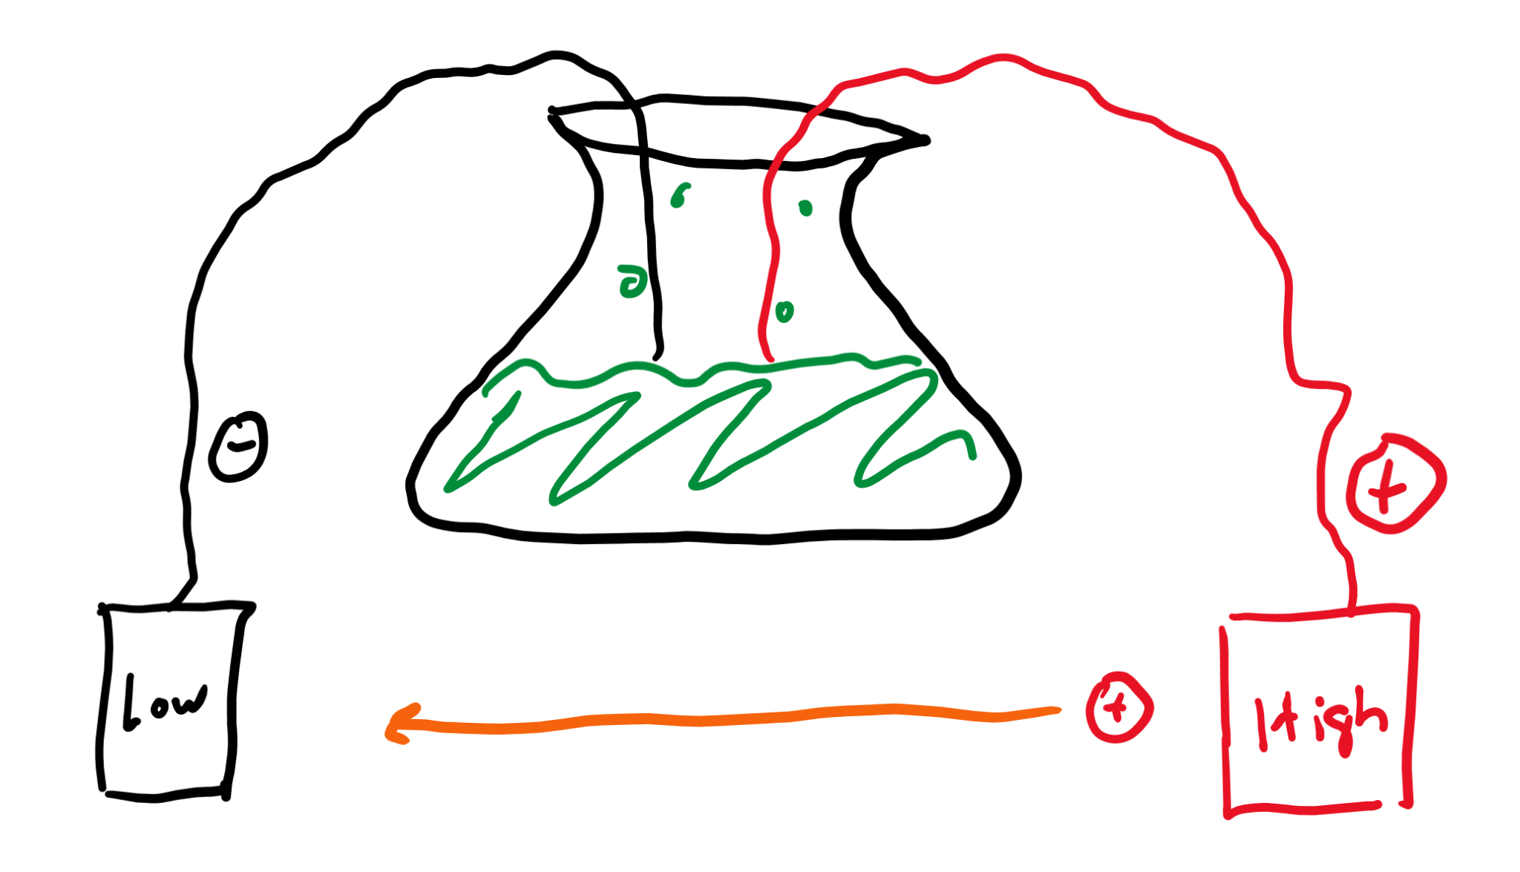
Batteries
Batteries generate a potential difference, or voltage, through chemical reactions.

Slide 9
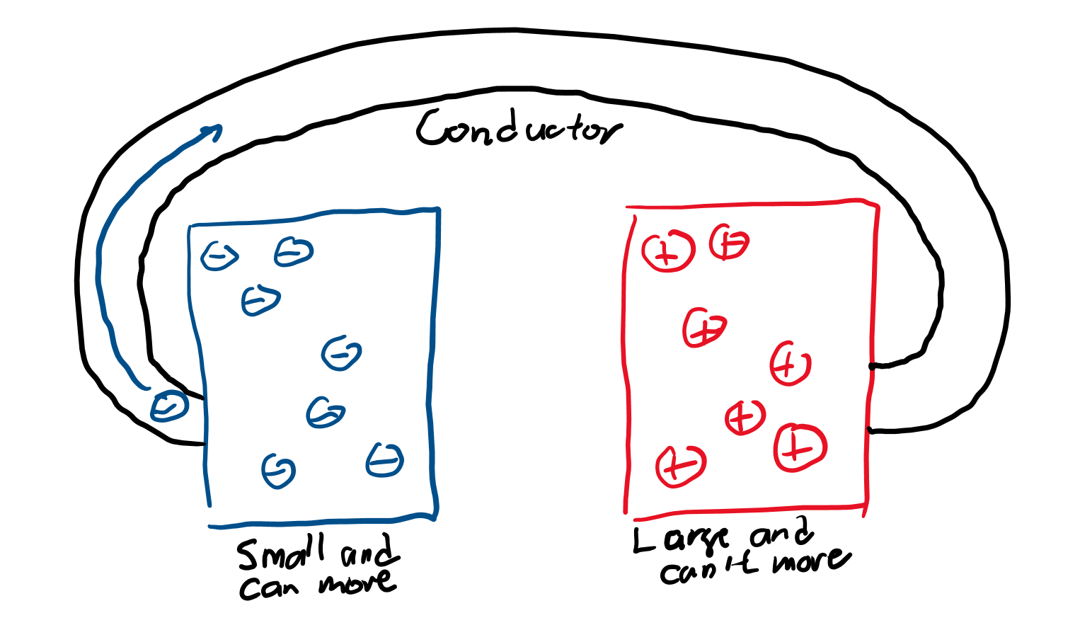
Current
Electrons are much smaller than protons and neutrons, so they’re the only charge carrier that moves in most circuits.
Current measure how fast/many electrons are moving in a certain amount of time.

Slide 10
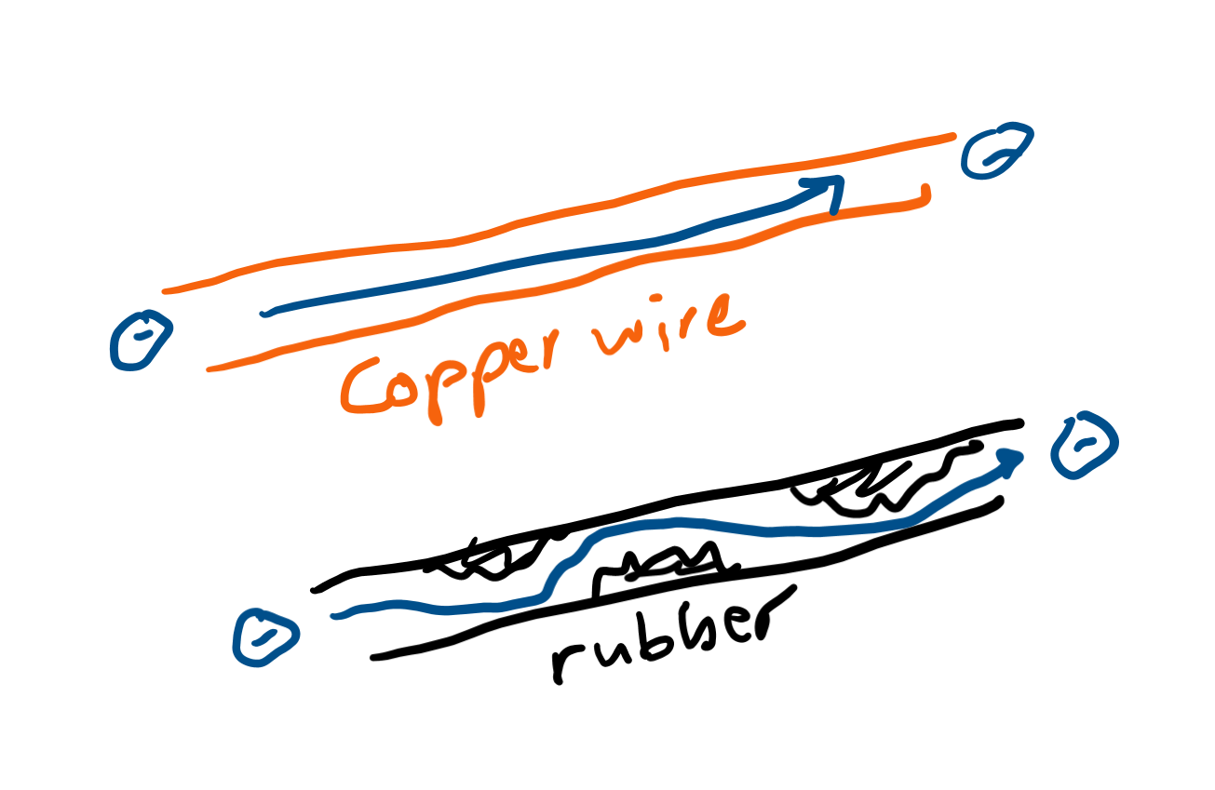
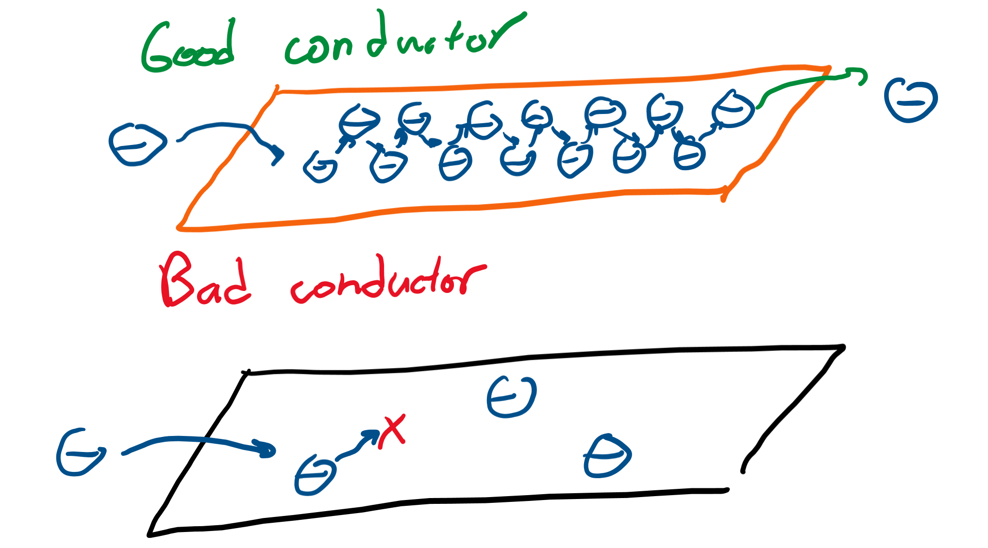
Conductors
Conductors are good at letting electrons flow.
Metals are good conductors because they act as a “sea of electrons” that allow “currents” to form easily.

Slide 11
Basic circuits

Slide 12
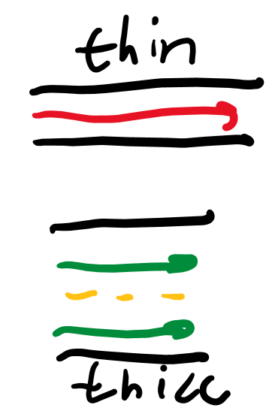
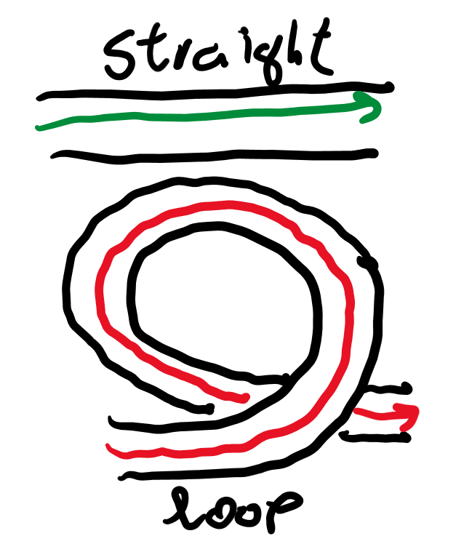
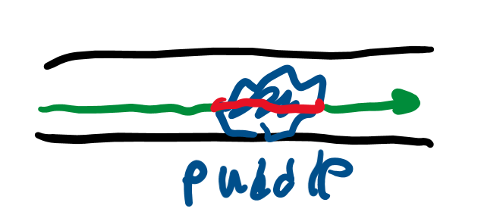
Resistance
If nothing slowed down the electrons in a conductor, a “short circuit” would happen as all the electrons would immediately flow from the low to high potential end.
Objects that are long, thin, and have high resistivity are very good at slowing down electrons, or “resisting” current.

Slide 13
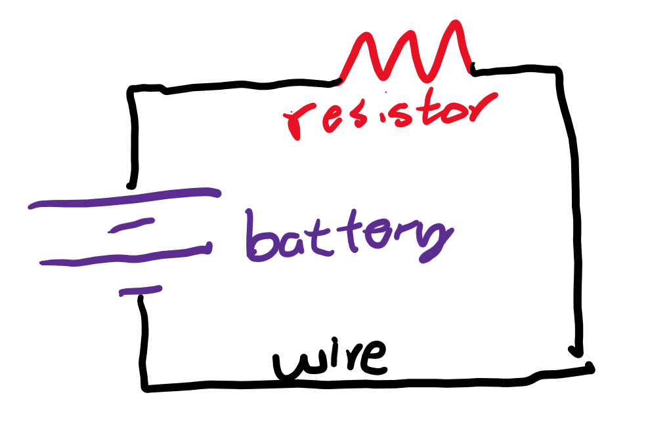
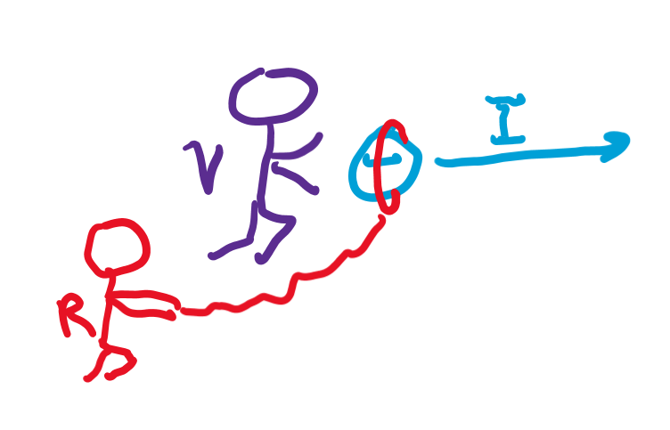
Resistors
Resistors are objects with high resistivity used to slow down current.

Slide 14
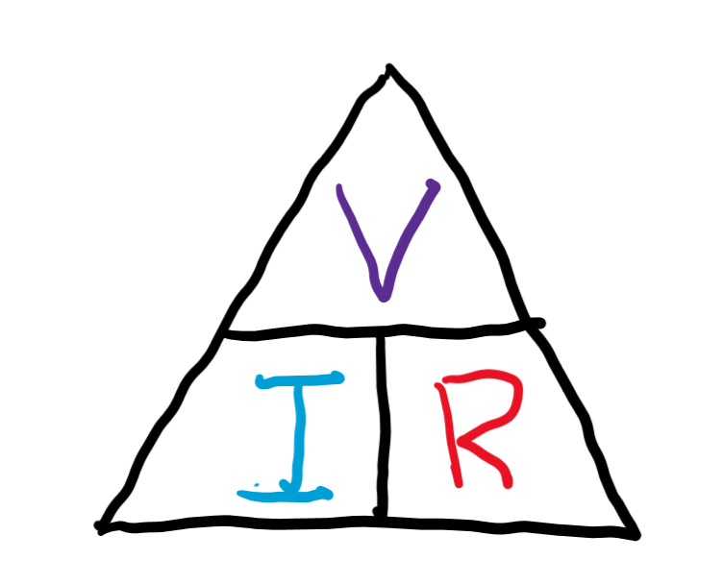
‘Ohm’s’ law
Ohm’s law says that voltage is proportional to current.
The exact relationship is V = IR
This can be rearranged into: I = V/R R = V/I
Where V is voltage, I is current, and R is resistance.

Slide 15
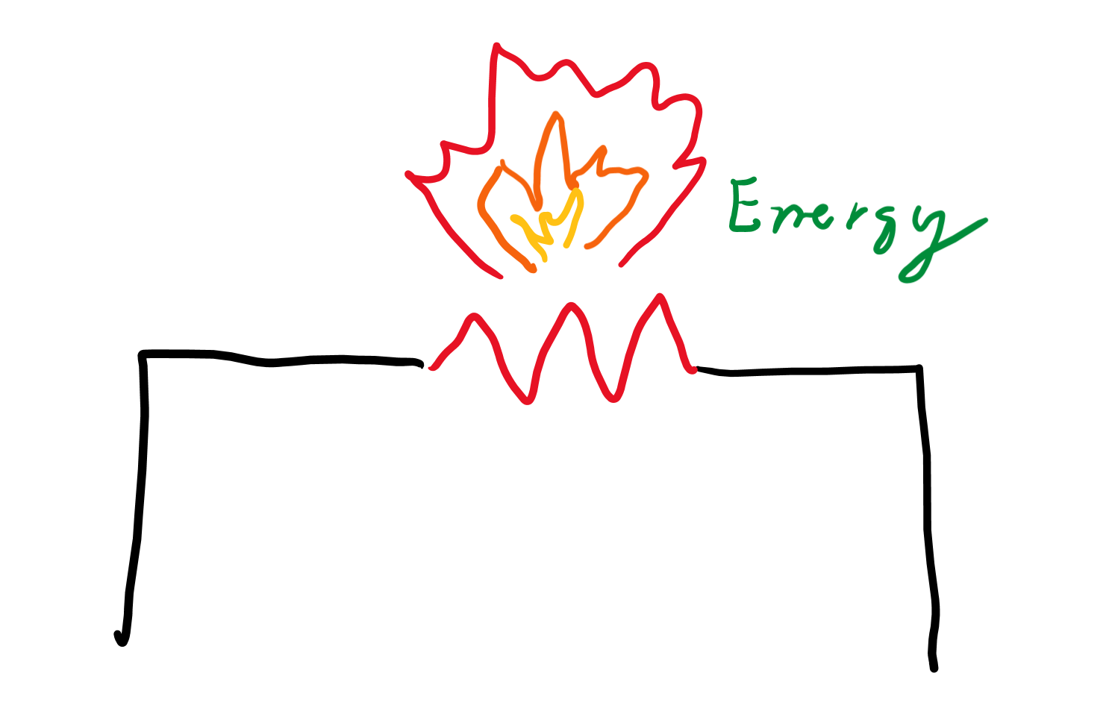
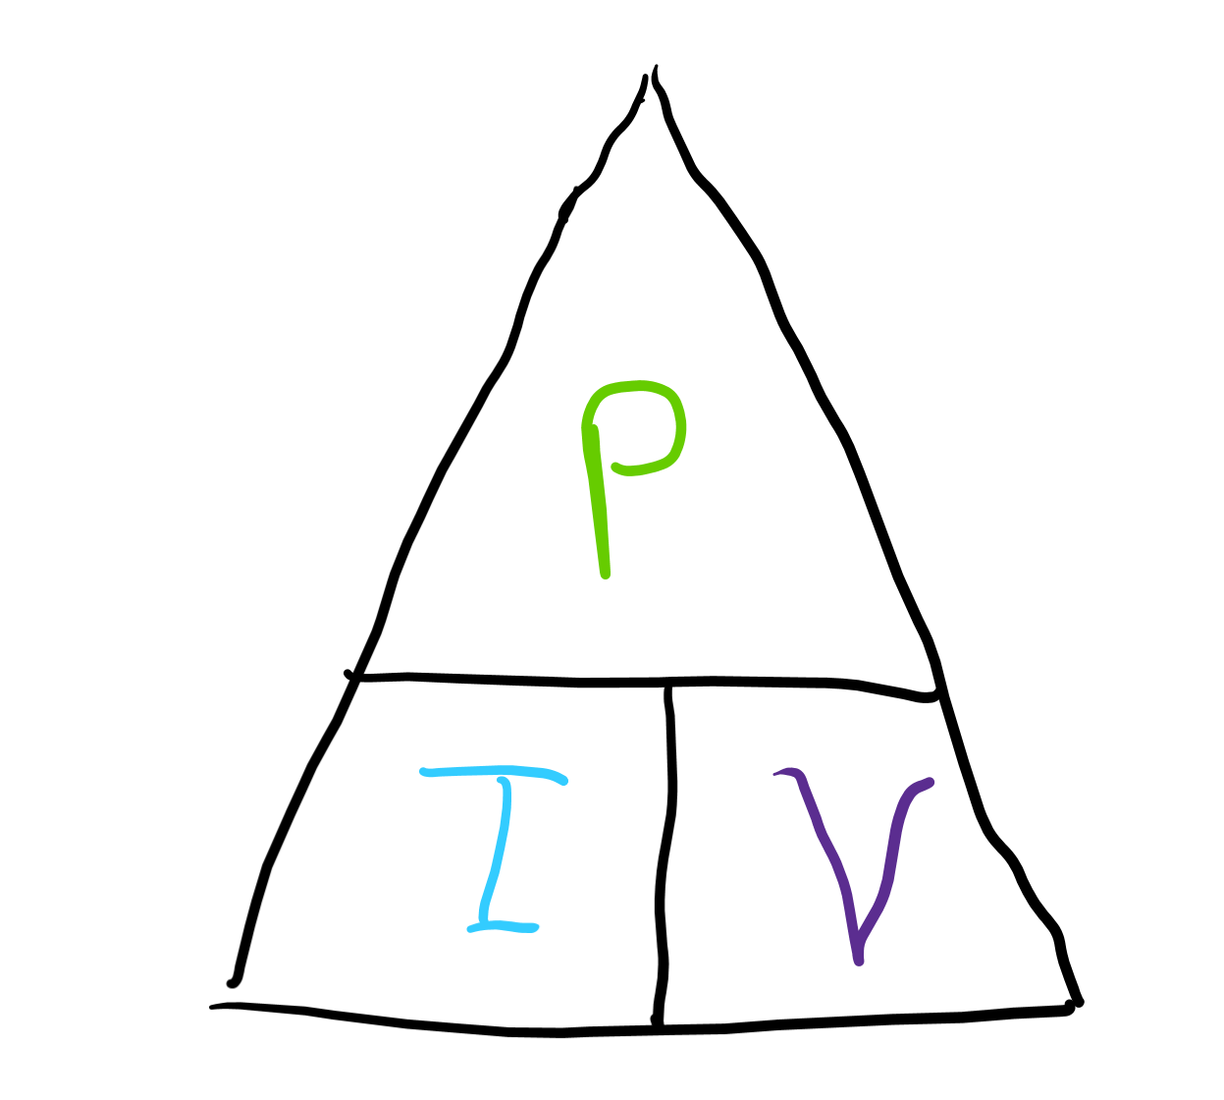
Power dissipation law
Because resistors slow down charge, they generate heat.
The power of a resistor is how much heat energy they can generate in some amount of time.
The equation to calculate power is: P = IV
Where P is power

Slide 16
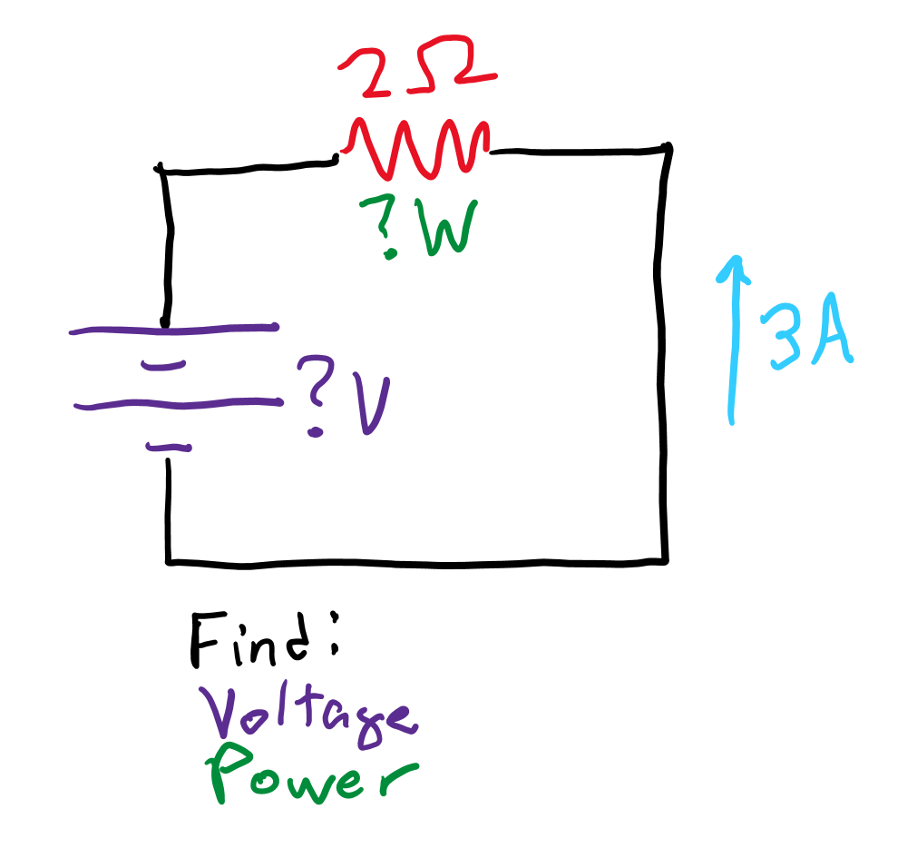
Sample problem
In a circuit with a single battery and resistor, the resistor has 2 ohms of resistance and the current supplied by the battery is 3 amps.
What voltage must the battery be providing?
What power is dissipated by the resistor?

Slide 17
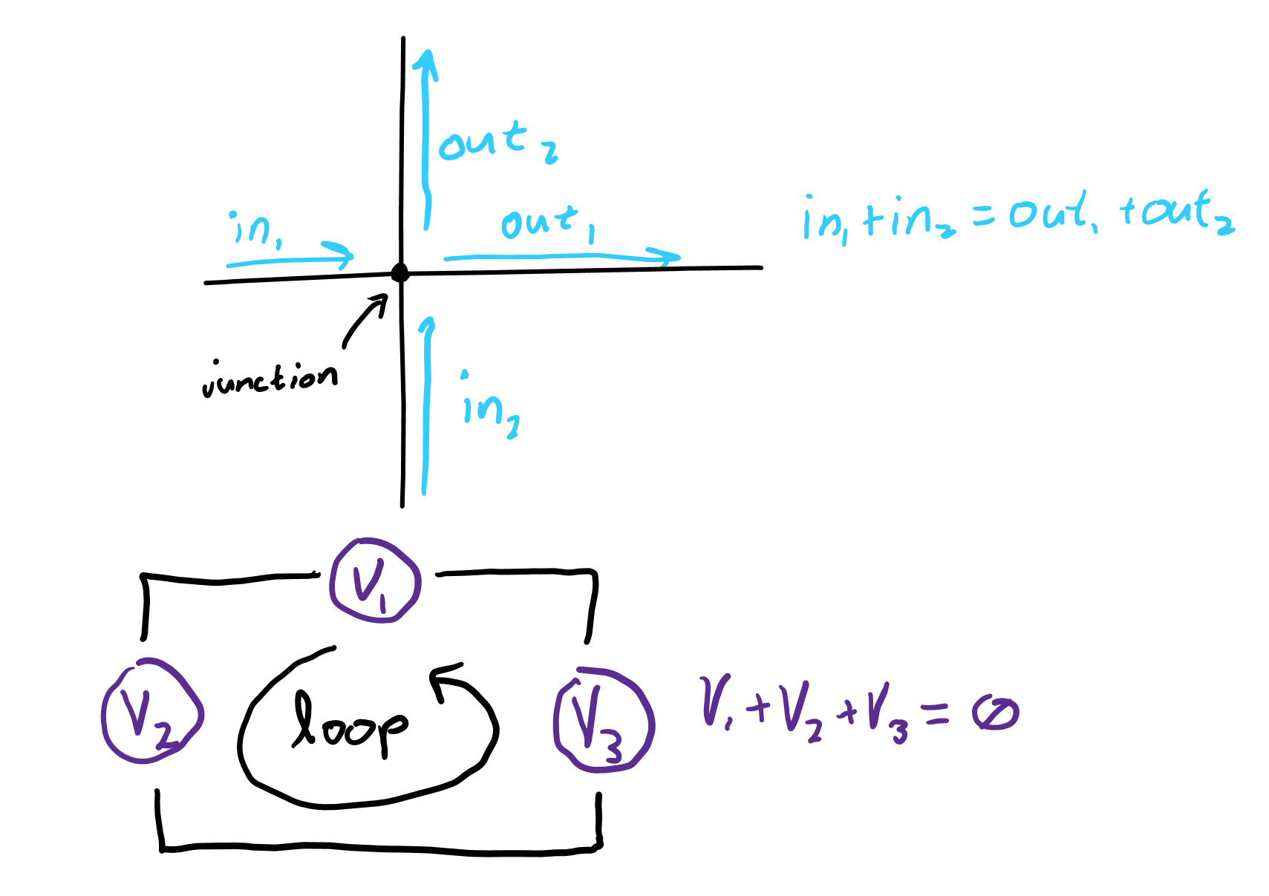
Kirchoff’s laws
Kirchhoff’s junction rule says the charge going into a junction equals the charge coming out of the junction. (First law.)
Kirchhoff’s loop rules says the voltage across a loop is zero. (Second law.)

Slide 18
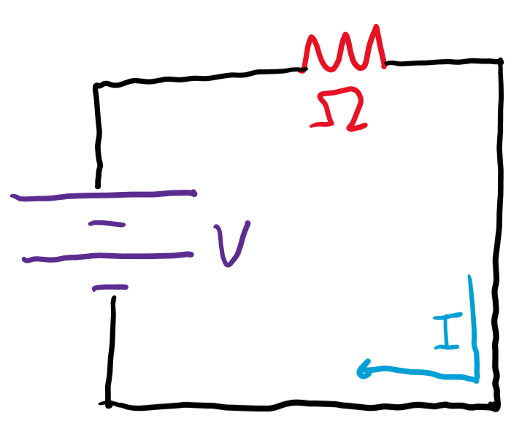
Simplifying a circuit
Thevenin’s theorem tells how voltage sources can be combined.
Norton’s theorem tells how current sources can be combined.
Rearranging Kirchhoff’s laws on an Ohmic circuit tells how resistances can be combined.
All circuits with voltage, current, and resistors can be simplified into the same circuit.

Slide 19
Circuits with Capacitors

Slide 20
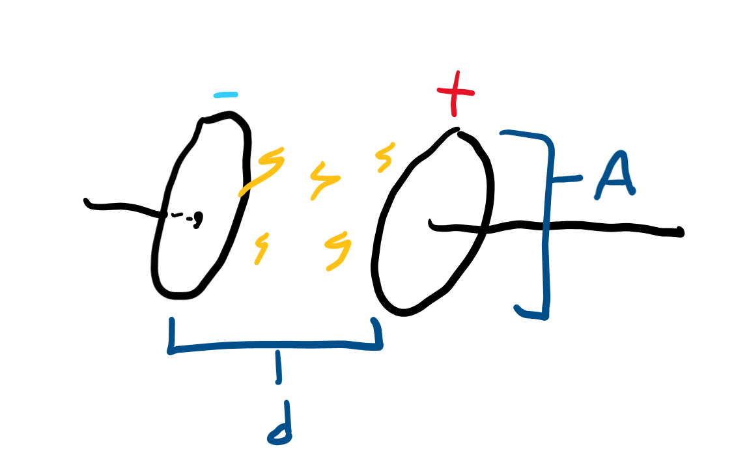
Capacitors
There are devices used to store charge and have “electric” potential energy.
Opposite charges are stored on each of the two plates of a capacitor, leading to a voltage across it.
Good capacitors have larger plates and smaller distances between plates.

Slide 21
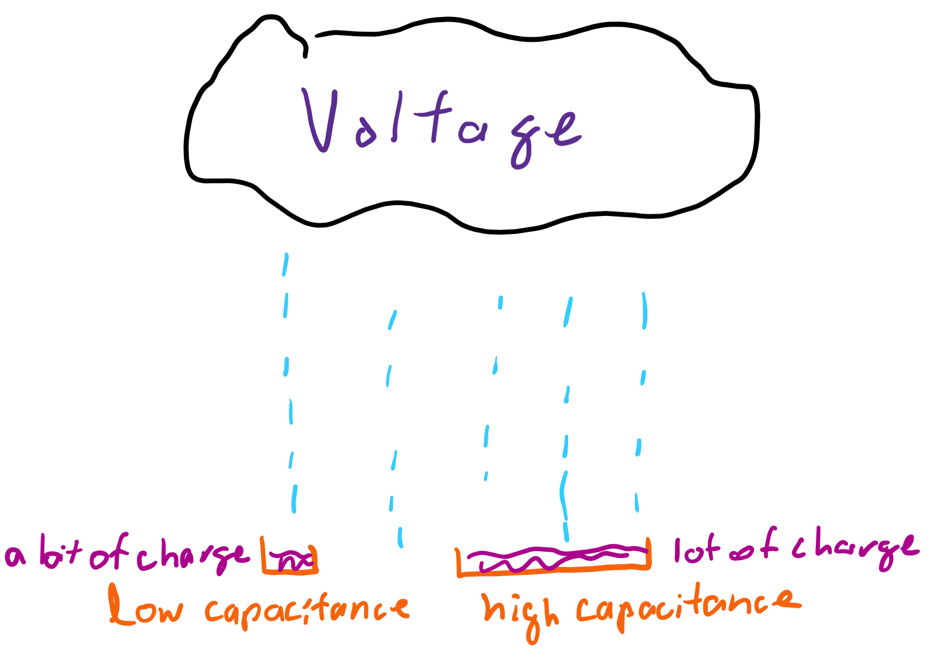
Capacitance
Capacitance is a measure of how good a capacitor is at storing charge.
Given a certain voltage, the higher the capacitance, the more charge a capacitor can store.

Slide 22
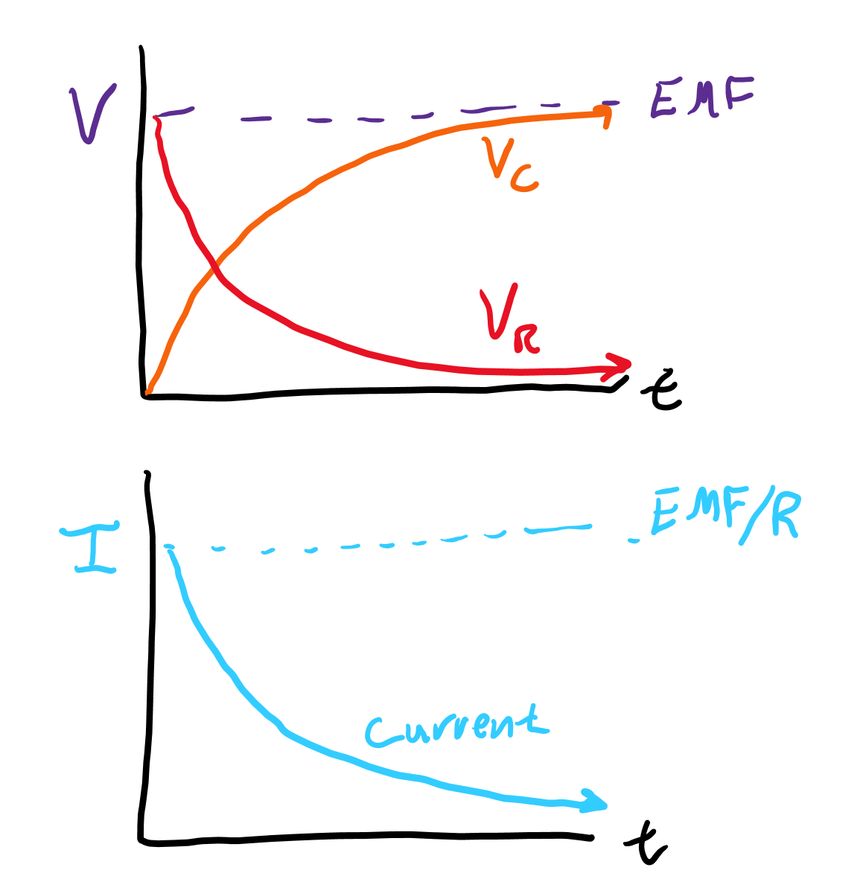
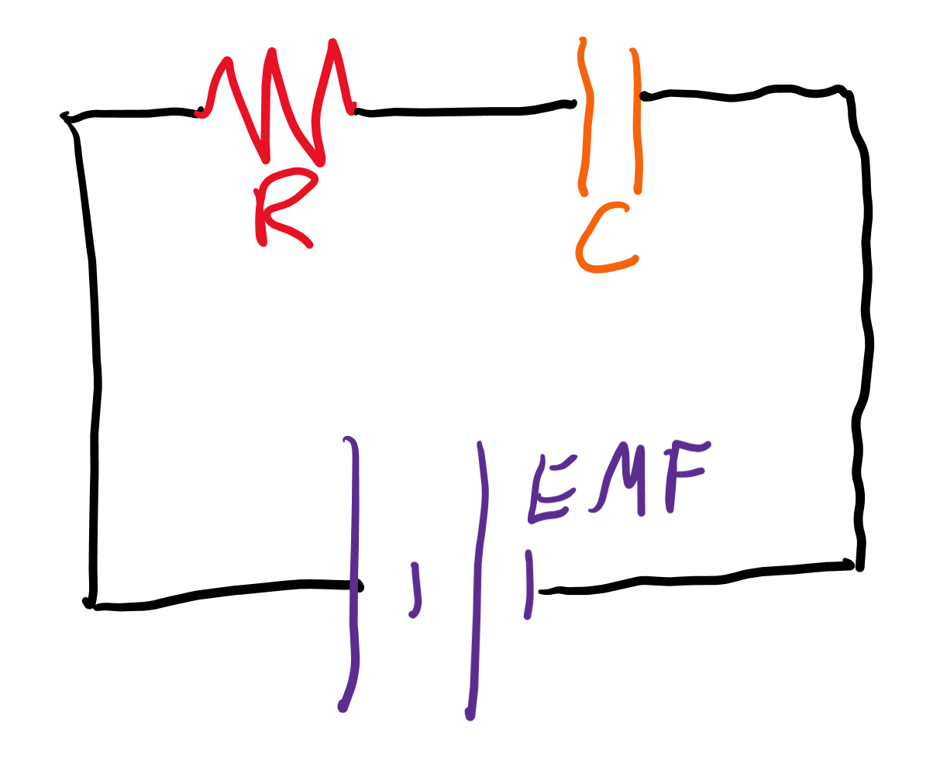
Charging a capacitor (RC circuit)
As the capacitor charges, the voltage across the capacitor increases, so the voltage across the resistor decreases, causing the current to decrease until the capacitor is fully charged.

Slide 23
Inductors and AC

Slide 24
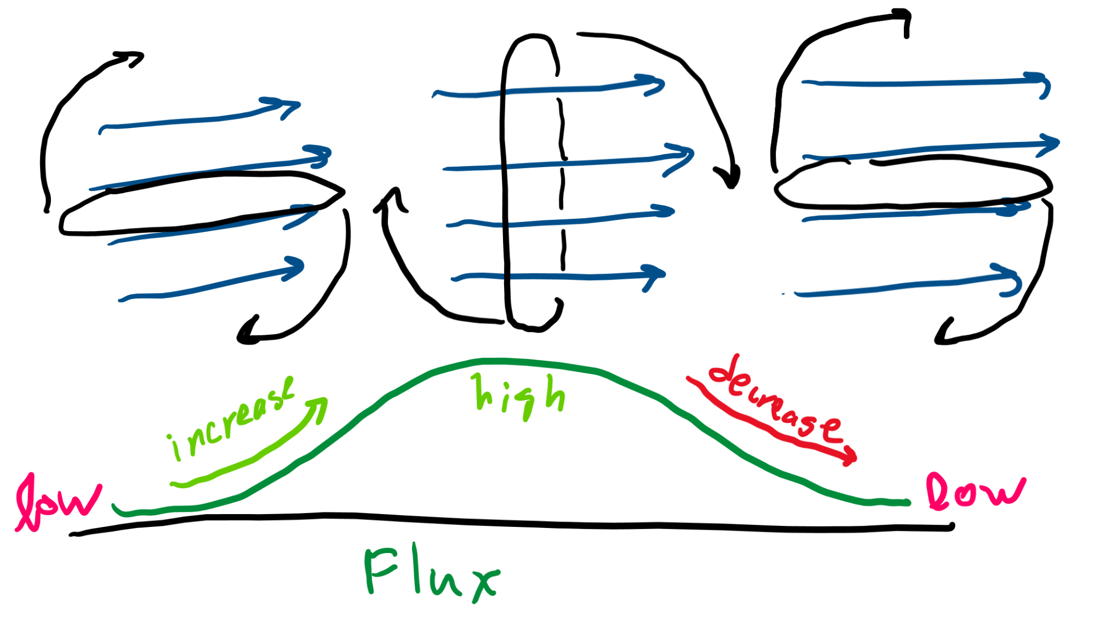
Magnetic flux
Magnets emit a magnetic field from them that travel from north to south poles.
Flux is a measure of how much of these magnetic field lines you’re “catching” in a loop of wire.

Slide 25
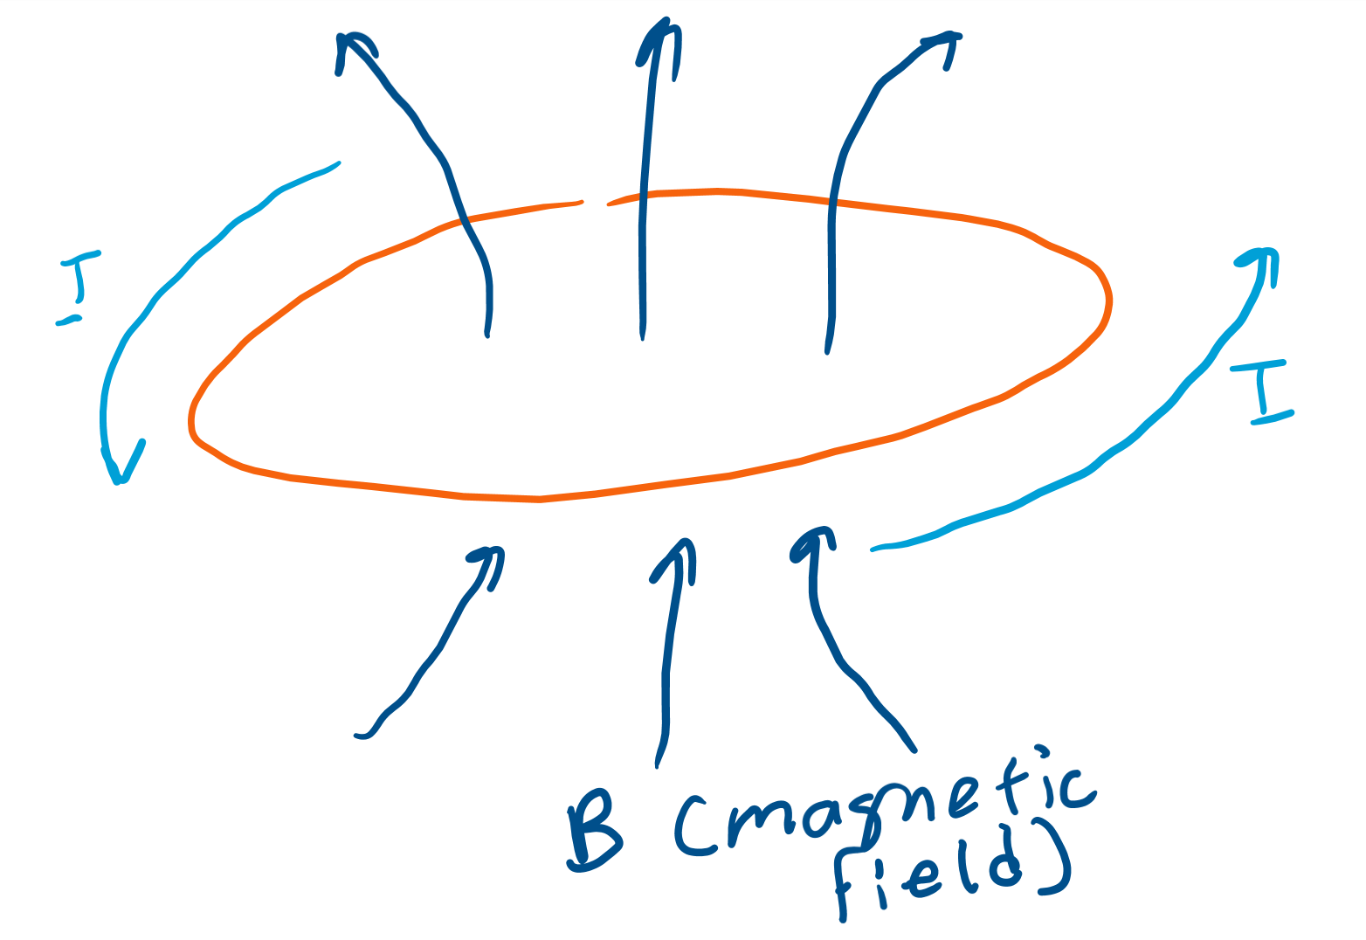
Induction
Current around a loop of wire can also produce magnetic fields.
These magnetic fields can be “caught” by the same wire to produce flux.

Slide 26
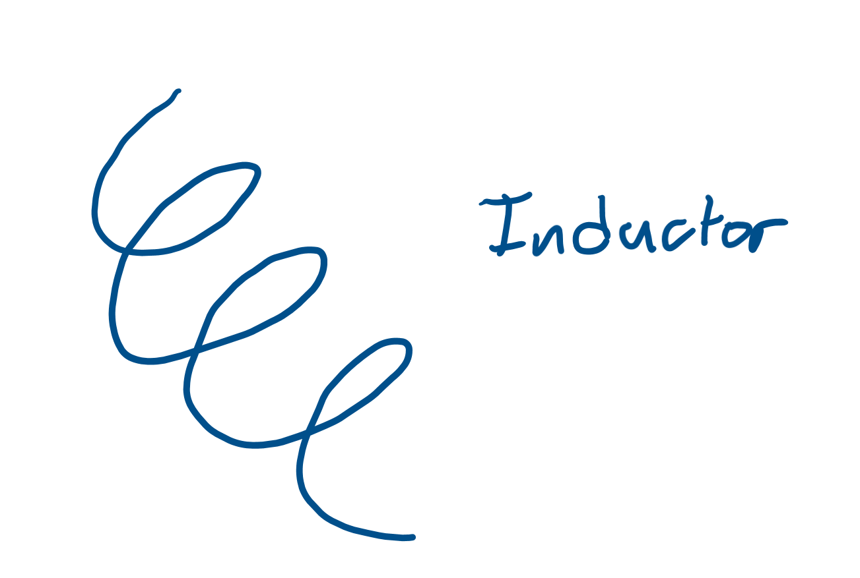
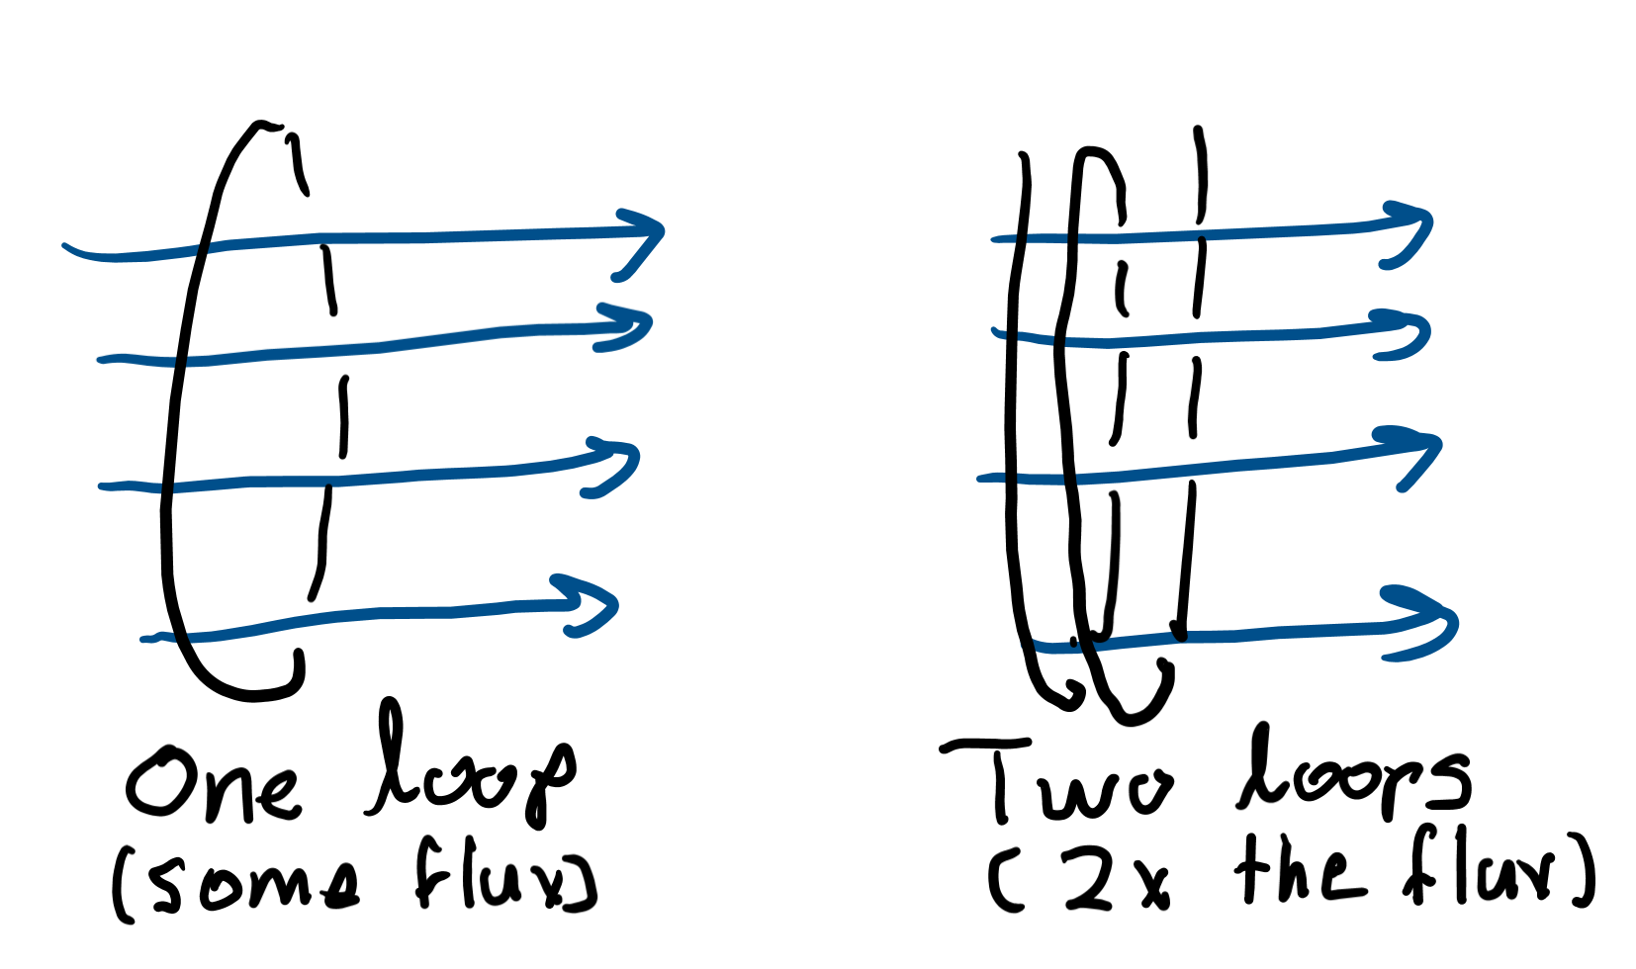
Inductors
Inductors are loops of wire that produce a lot of flux from current.
When current passes through them, they convert electrical energy into magnetic energy through induction.

Slide 27
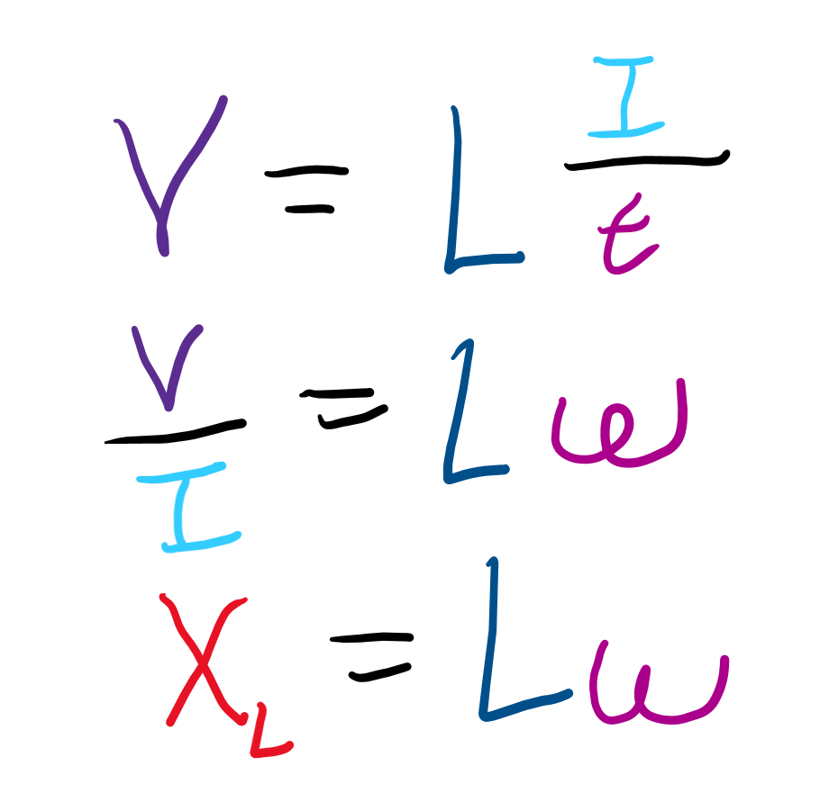
Inductance
Inductance tells how well an inductor can charge given a certain change in current.
If current changes, a good inductor (that has high inductance) will gain a high voltage while a poor inductor will gain very little voltage.

Slide 28
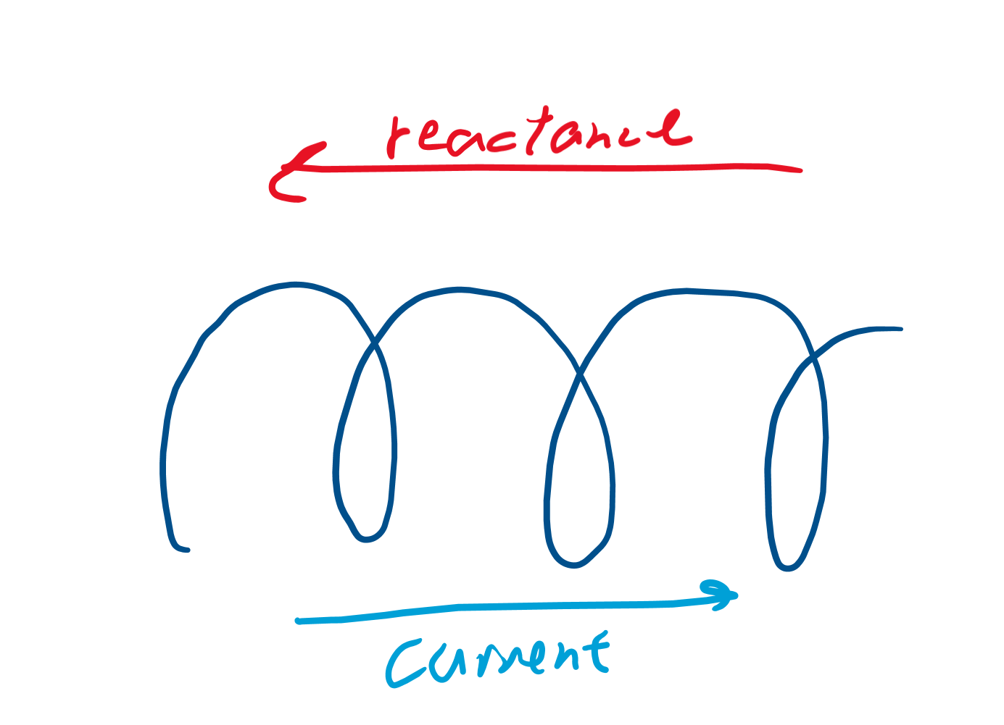
Reactance and impedance
As magnetic fields are generated in inductors, current flow more easily through them. This “resistance” that disappears as magnetic fields form is called reactance.

Slide 29
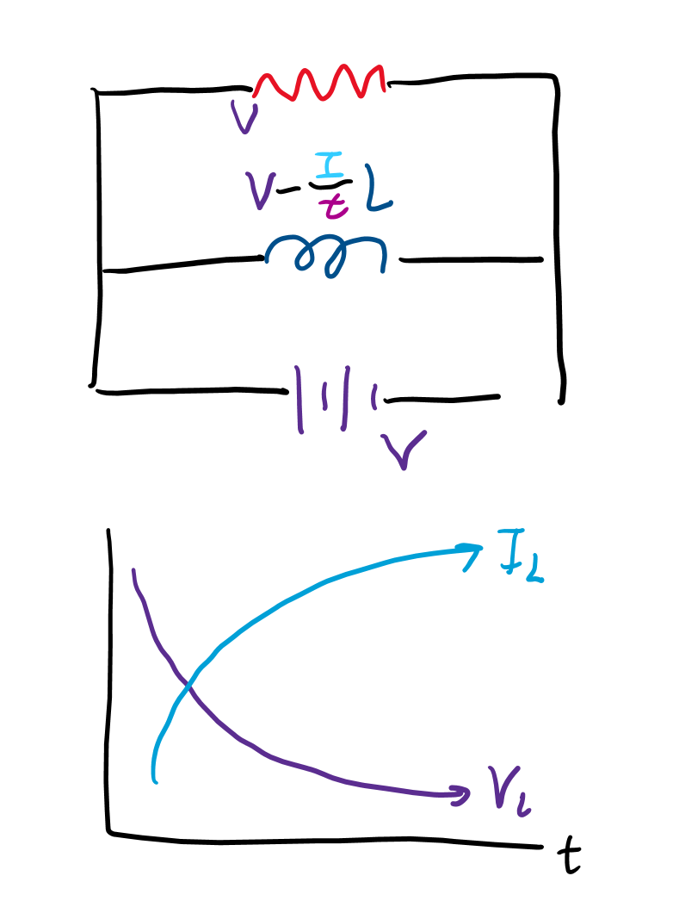
Charging inductors (RL circuits)
Inductors convert EMF (voltage) into magnetic flux, so the voltage across inductors decreases. However, the current increases more and more since the reactance disappears as the magnetic field is formed by the inductor.

Slide 30
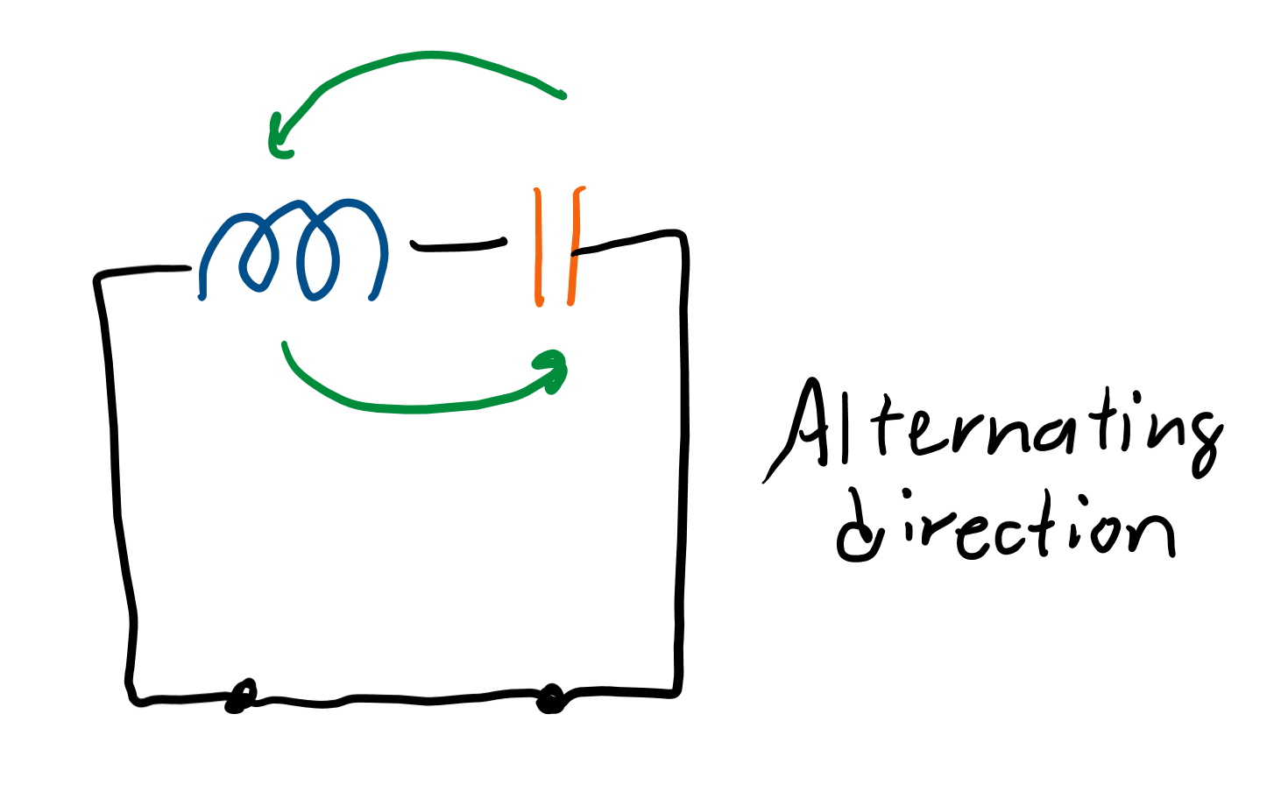
LC circuits
LC circuits oscillate direction as they travel from the inductor to the capacitor back to the inductor and on and on.
Energy is converted back and forth from magnetic (inductor) to electric (capacitor).
This type of current is called an “alternating” current.

Slide 31
More with AC/DC

Slide 32
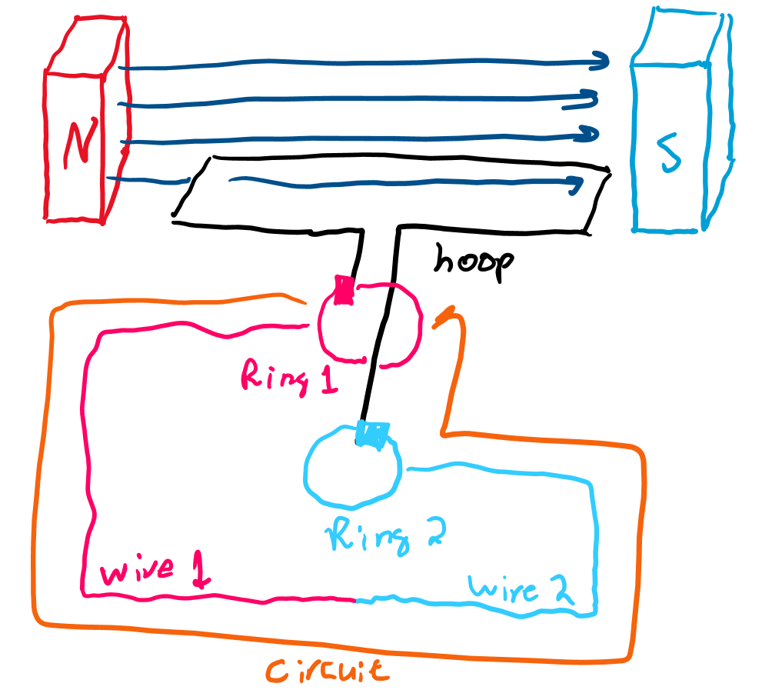
Alternators
These circuits convert a DC current into an AC current.
The DC power is used to spin a hoop of wire that gains and loses flux. When it gains flux, current in the hoop travels on way. When it loses flux, current travels the other direction.

Slide 33
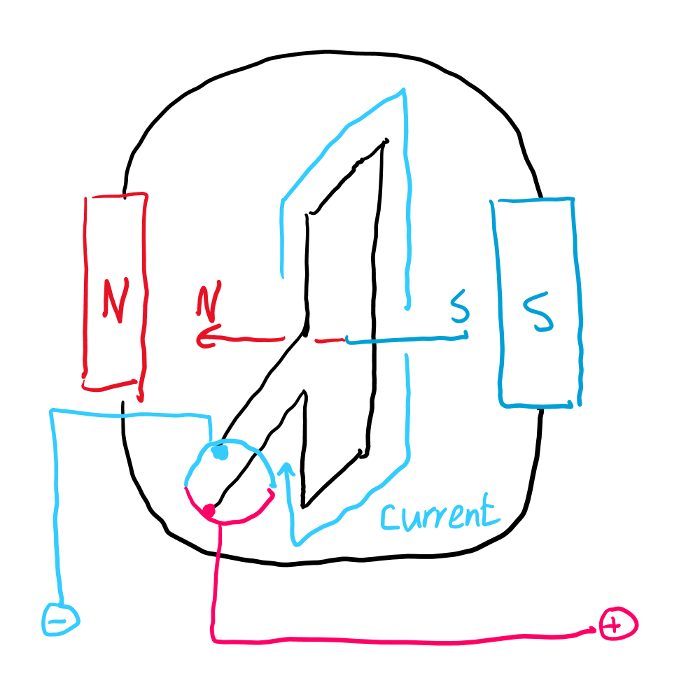
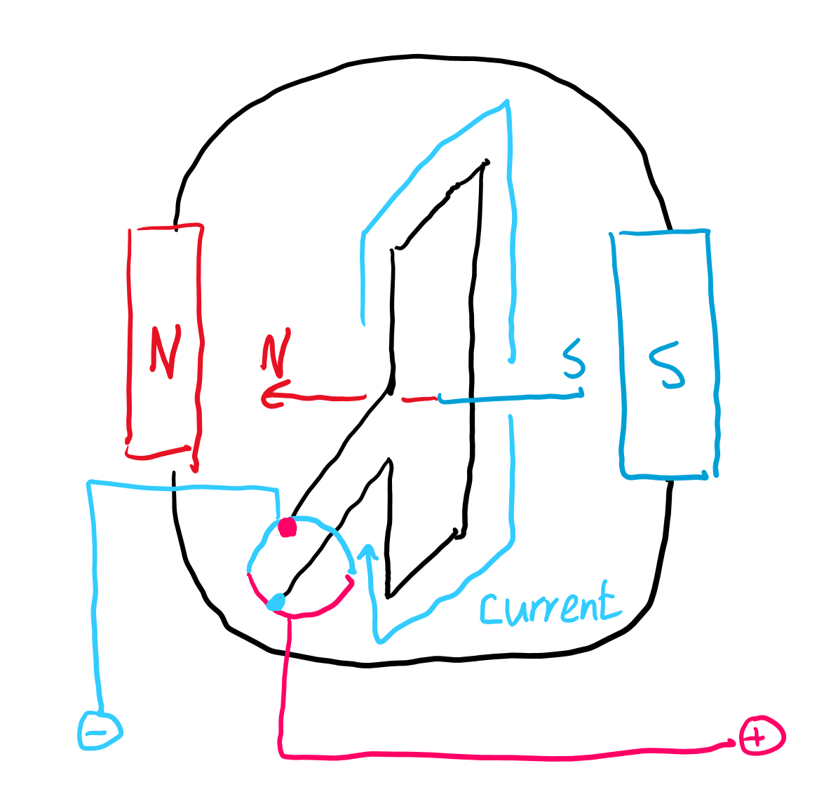
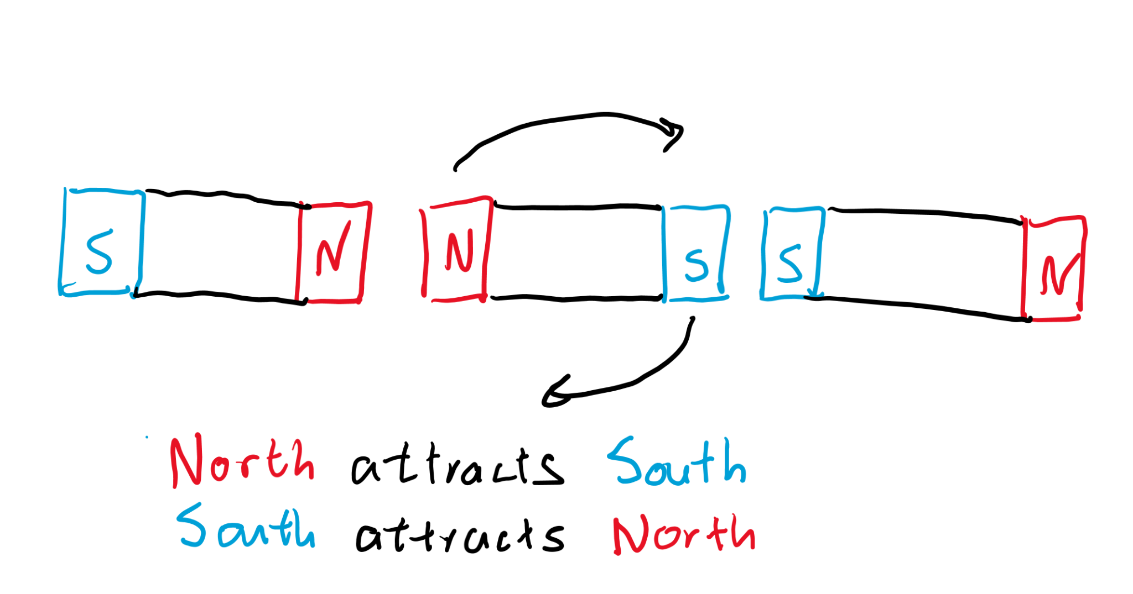
Motors
Motors use DC power to spin an object in between two magnets.

Slide 34
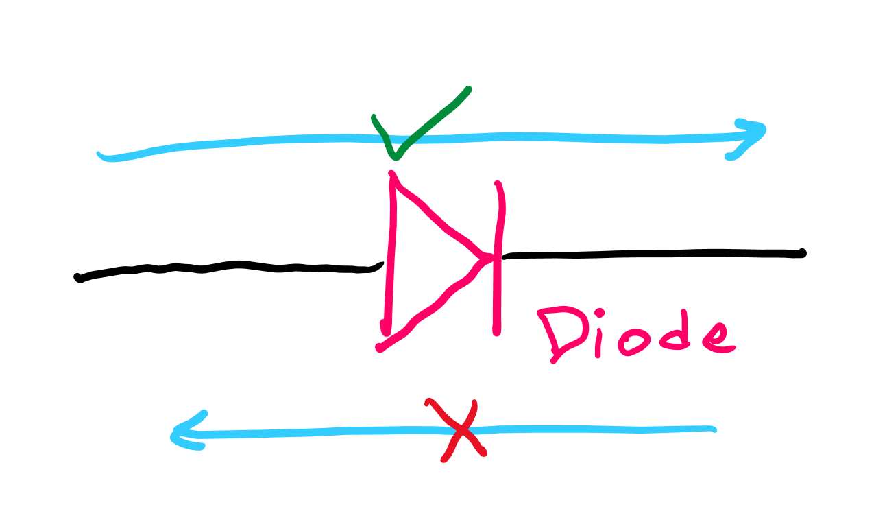
Diodes
Diodes restrict motion of charge in a single direction and prevent current from flowing in the opposite direction.
Diodes attached to an AC circuit would only let half the current flow.

Slide 35
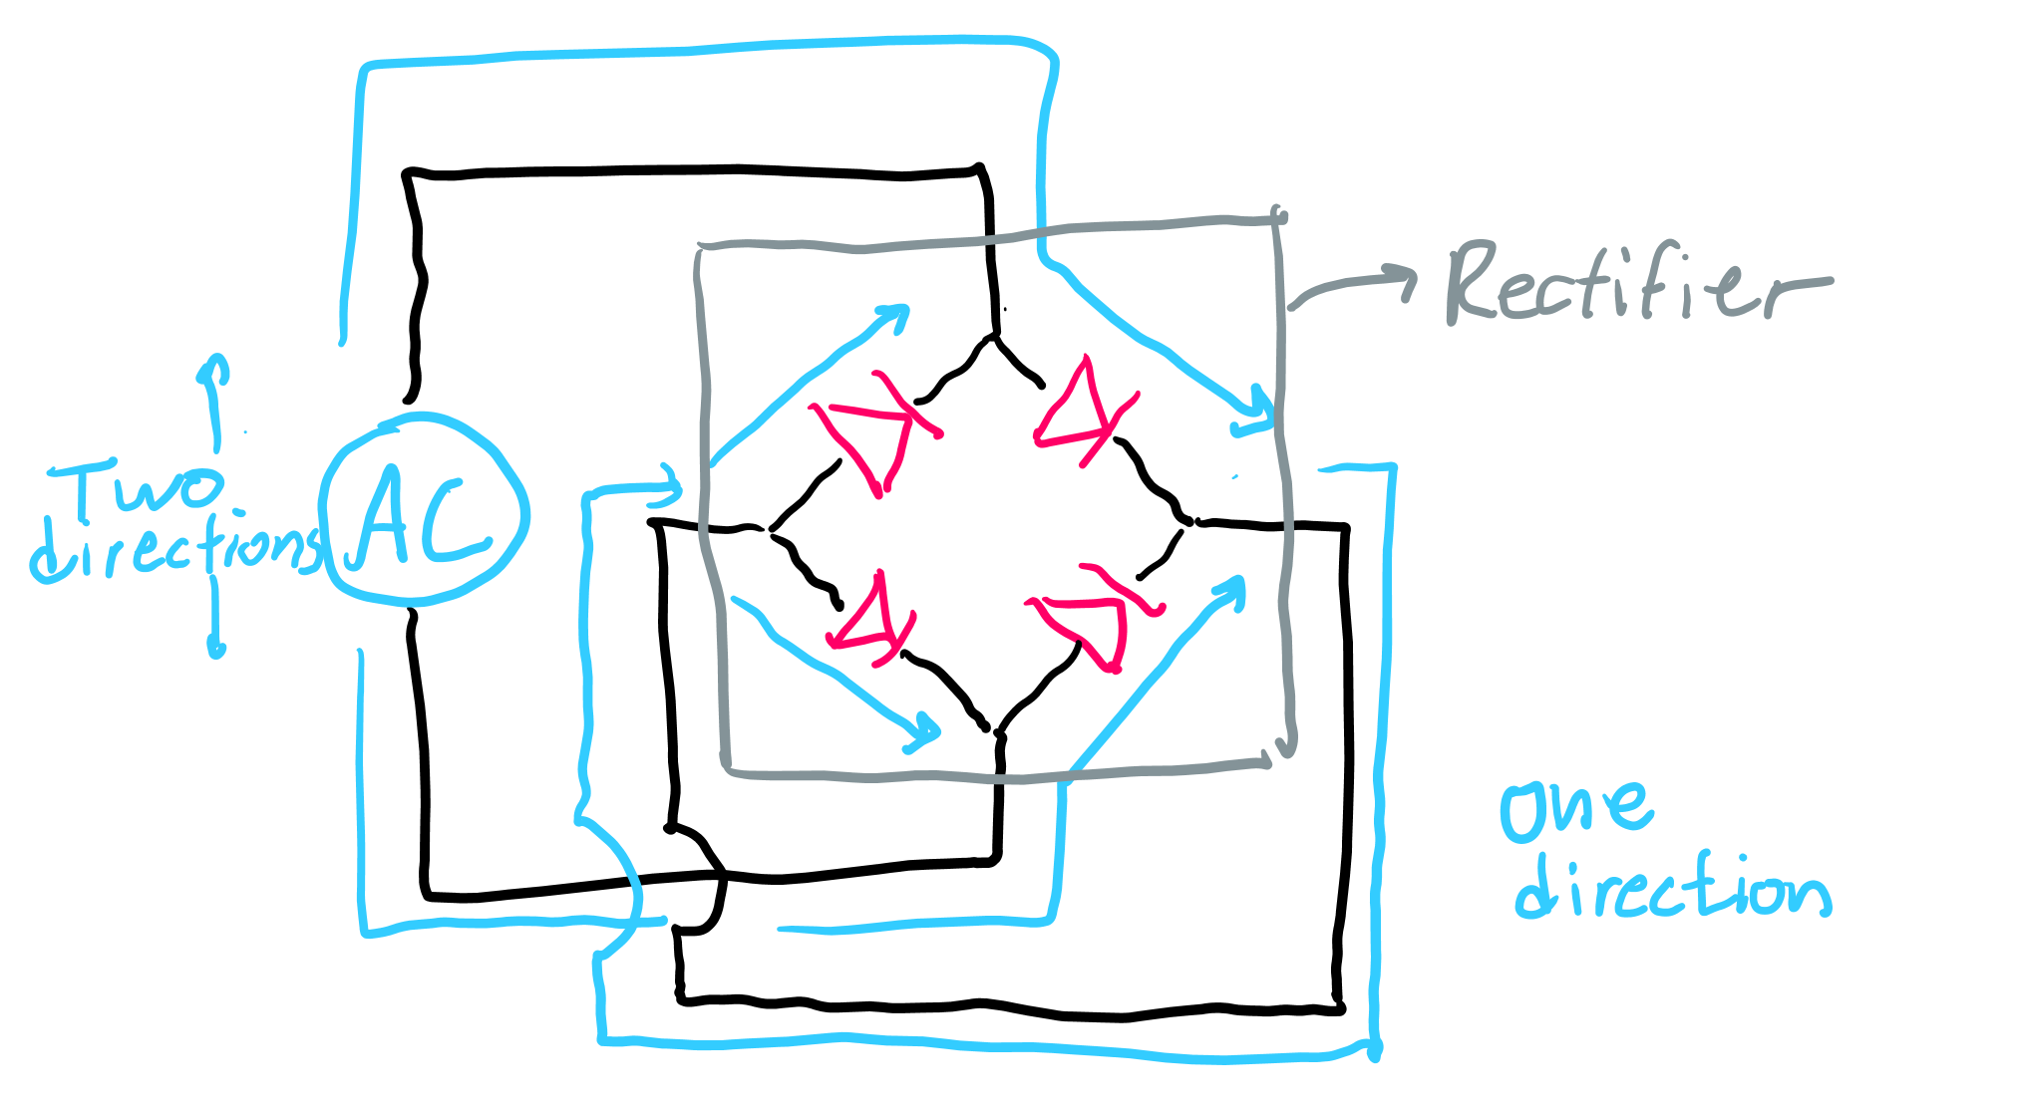
Rectifiers
Rectifiers are an arrangement of diodes that can fully turn all AC into a DC circuit.
A single diode would only be able to turn half the AC into DC.

